Slide 1

SIT105 - Critical Thinking and Problem Solving for IT Class 06
Part 1 - Steps in Algorithm Development
Part 2 - Building Algorithms
Dr. Frank Jiang
Frank.Jiang@deakin.edu.au

Slide 2
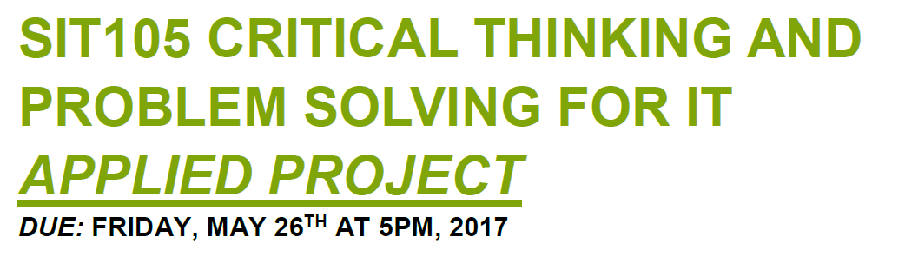
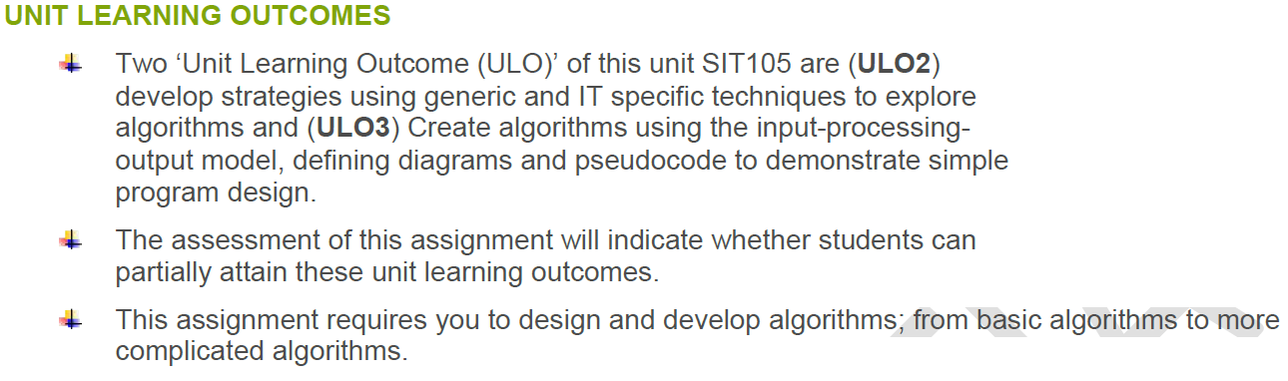

Slide 3

Part 1 Content
Programming/Algorithm Essentials
Program/Algorithm Development
References

Slide 4



Quote of the week
To use: Apply shampoo to wet hair. Massage to lather, then rinse. Repeat.
A typical hair-washing algorithm that fails to stop! —
In our algorithms, programs and apps we must avoid an infinite loop!
Quote by: Gary William Flake
Author of the book:
Computational Beauty of Nature

Slide 5
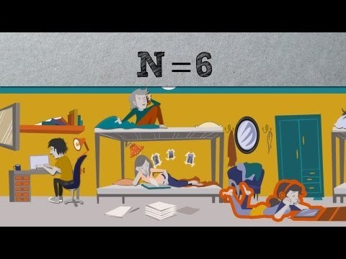
What is an Algorithm ?
What's an algorithm_ - David J. Malan.mkv

Slide 6
What are Essentials for Programming?
Data – inputs/outputs
Algorithms – sets of instructions
Modules, tasks, procedures, functions – to perform some operation.
Order of tasks – e.g. which function will be done first.
Associating data with tasks – inputs into functions.
Refinement of data – identifying relevant attributes and tasks/sub tasks

Slide 7
Refinement of Data
Identifying relevant attributes
What would a student record consists of?
identification number
name
address
course
and others
What are the chunks of data involved?

Slide 8
Refinement: Attribute Data
What would each of these parts consist of?
identification number
name
address
course
Year, unique number
Given name, family name
Street, suburb, postcode, …
Code, title
Can we split these into parts?

Slide 9

Refinement of Data
Have a think!
How could we break down the following examples of data refinement:
A supermarket receipt consists of ...
A bank account consists of ...
The ‘Critical Thinking’ text consists of ...

Slide 10
Refinement of Algorithms
Identifying sub tasks!
For example, main task:
withdrawing cash from an ATM
Sub tasks: The ATM will
- machine waits for card
- prompt for PIN and obtain PIN
- check PIN using card information
- if PIN incorrect, terminate and reject card
- if PIN correct. proceed with the following
- prompt for and obtain cash amount
- prompt for and obtain account type
- process transaction
- eject card, cash and receipt
Can probably break this down into even smaller tasks

Slide 11

Refinement of Algorithms
Have a think!
What are the sub-tasks for these examples?:
Riding a bicycle for at least 1 km consists of ...
Making a cup of coffee ...
Cooking rice …

Slide 12
Steps in Program Development
Define the problem we are trying to solve
Outline the proposed solution
Develop an algorithm
Check that the algorithm is correct
Represent the algorithm in a programming language
Run the program
Documentation
Look at these in more detail

Slide 13
Step 1. Define the Problem
Defining the problem is:
to produce requirements (obtained from client).
What your program should do
to produce specifications based on those requirements (obtained from developer).
How you plan to do it
Difficult because :
we might overlook some characteristics of the problem
some requirements might be misinterpreted, vague, ambiguous, general, or conflict

Slide 14
Step 1. Define the Problem
The specification will normally include/describe:
Input data that the program requires
Transformations/processing to be performed on this data
Output data that the program must produce
and
Input data to each sub-task of the program
Transformations for each sub-task
Output data from each sub-task
Needs?
What does it do?
Produced?

Slide 15
Step 2. Outline the Solution
This is an early draft of the solution.
It consists of:
tasks, subtasks
data descriptions
mainline logic (the main tasks in reasonable order)
diagrams (UML, ER, DFD, hierarchy charts, ... )
E.g. this task is to display a login screen
Unified modelling language
Entity relationship diagrams
Data flow diagrams
E.g. high level instructions or statements

Slide 16
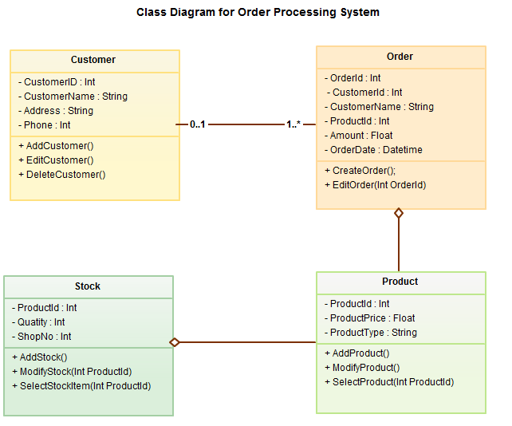
Diagrams
UML is a way of visualizing a software program using a collection of diagrams.

Slide 17
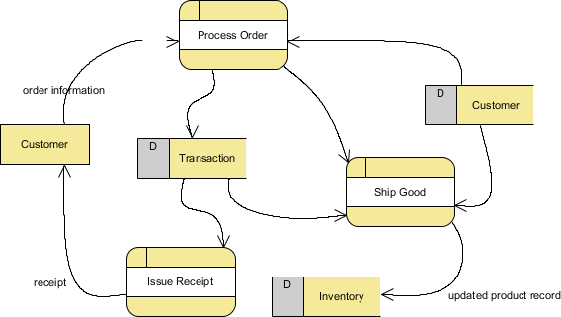
Diagrams
A Data Flow Diagram (DFD) is a graphical representation of the "flow" of data through an information system, modelling its process aspects.

Slide 18
Step 3. Develop an Algorithm
Produce an algorithm from Step 2 (Solution Outline)
consisting of very specific instructions.
E.g., some specific instructions
PRINT "enter age"
READ age
IF (age > 12) and (age < 20) THEN
PRINT "you are a teenager"
ELSE
PRINT "you are not a teenager"
END-IF

Slide 19
Step 4. Check that the Algorithm is Correct
Go line-by-line and test the outputs to see if it matches what is expected
Usually called a desk check.
Use pencil and paper.
Choose a set of test data
Write down all expected results, independent of the algorithm
Using the algorithm, obtain actual results by evaluating each statement in detail, one statement at a time
record all changes to variables
record all outputs
Compare actual results from 3 to the expected results from 2
Valid and invalid test data

Slide 20
Step 5. Convert the Algorithm to Code
If the algorithm is correct, write the algorithm in the language of choice (C in the example below).
Usually, each statement of the algorithm translates to a single statement of the chosen language.
printf("enter age");
scanf("%i", &age);
if(age > 12 && age < 20)
printf("you are a teenager");
else
printf("you are not a teenager");

Slide 21
Step 6. Run the Program
Another program to turn our code into a program
Compile the program.
Run the program using the test data.
Compare these actual results with expected results.
(If needed) Fix errors and go back to 1.
The program can be tested on real data.

Slide 22

Step 7. Documentation
We need to have a set of documentation to go along with our program, some of these are:
Program documentation
User documentation
Systems/Admin documentation

Slide 23

Program Documentation
Intended to be read by a programmer
Consists of:
algorithms
data dictionary (comprehensive description of variables in our program)
test data and results
diagrams (of task, subtasks, data) – UML/DFD/ERD
explanations placed within the program
// these are my comments
// coder: xxx

Slide 24
User Documentation
Intended to be read by the user of the program
User manual
How the program operates. E.g.:
How to install
How to load
Keys used

Slide 25
Systems/Admin Documentation
Intended to be read by a IT administrators and systems staff
Installation instructions
Systems instructions. E.g.
account creation, deletion, management
security management
updating versions
installing patches
backups
E.g. how to setup student accounts for Cloud Deakin ?

Slide 26

Part 2
Building Algorithms

Slide 27
Part 2 Content
Top-down Development // section 1.3
Modular Development // section 1.3
Algorithms // section 1.4
Pseudocode // section 1.4
Writing Pseudocode // section 2.1
The Structure Theorem // section 2.3
References
6 Sections from Extract 11 and 12

Slide 28
Top-down Development
This is a method of steps to refine a solution.
outline a general solution
partition this general solution into more detailed sub-tasks
continue this refinement process until all sub-tasks are manageable
General idea
Into chunks
Into more chunks
That the particular chunk is small.
And easy to maintain

Slide 29
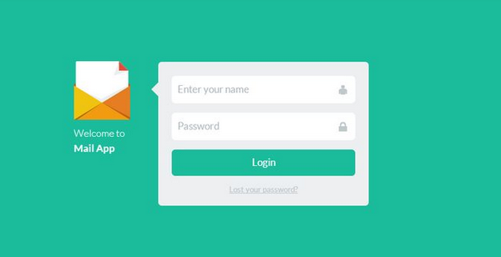
Top-down Development
For example, login task (e.g. login to gmail).
The login task may have the following sub-tasks.
Display login screen
Verify username and password (until correct)
Grant access
Continued.
Some systems may only give you 3 chances!

Slide 30
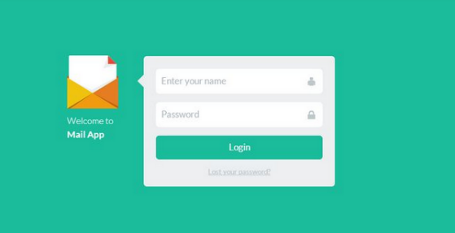
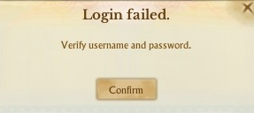
Top-down Development
The login sub-tasks may have their own sub-tasks.
display login screen
display prompts
display text boxes
display buttons
verify username and password (until correct)
get username
get password
check username and password
grant access
remove login screen
display GUI for user
Broken down into sub tasks – 1,2,3

Slide 31
Modular Development
Modular development is the process of subdividing a computer program into separate sub-programs.
Modular development:
A module performs a logical task
more so logical from a technological sense – if login success then gain entry
E.g. non logical – sending your password to every email to every account on the system after logging in.
make modules small (easier to understand). 1-20 lines good.
Place repeated code into a module – saves rewriting
Code Manipulates Data

Slide 32

Algorithms
An algorithm is a set of instructions which specify how to perform a data manipulation task.
These instructions should:
Be detailed!
Be unambiguous!
Terminate! (this is not a problem with everyday algorithms, but computer programs sometimes they get stuck in infinite loops)
E.g. with the quote of the week for washing hair

Slide 33
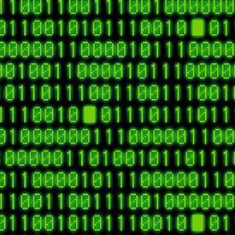
Pseudocode
Tool for writing algorithms, so that people can understand them!
Pseudocode is:
a high level language
a non-programming language
Cant build a compiler to build a program off this.
used for writing (abstract) algorithms which:
lack details of programming languages
are easy to understand

Slide 34
Writing Pseudocode
There are six basic operations
Receive data - inputs
Output data – something that has been processed
Evaluate expressions – e.g. what is 1+1=
Assign a value to a variable – e.g. x=1 y=1
Select a group of statements
Group of statements – you want execute them sometimes based on some kind of event.
Repeat a group of statements
Repeat a bunch of statements more than once

Slide 35

1. Receiving Data
READ or GET obtains data from:
The keyboard
A file
A socket
E.g.,
READ student_name
READ data FROM data_file
GET price1 price2 price3

Slide 36
2. Data Output
PRINT, WRITE or PUT causes data to be written to:
the computer screen
a file
a socket
E.g.,
PRINT student_name
PRINT data TO data_file
WRITE price1 price2 price3

Slide 37
3. Evaluation of Expressions
Arithmetic expressions (mathematical)
price1 + price2 + price3
x * x + 2 * x + 5
Relational expressions (comparing things)
x = 0
12 < age < 20
Logical expressions (and or and not)
12 < age AND age < 20
x > 0 AND y > 0
p1 AND p2 AND (p3 OR p4) OR NOT (p5 AND p6)
Not limited to these!

Slide 38
4. Assigning a Value to a Variable
variable = expression
The expression on the right side of the assignment operator is evaluated and the result is stored in the memory location (the variable) named on the left side of the operator.
E.g.,
price1 = 100
price2 = 250
price3 = price2 * 1.20
total_price = price1 + price2 + price3
With a variable you can store data into memory.

Slide 39
5. Selection (IF statement)
Characteristics:
keywords (usually IF, THEN, ELSE and ENDIF)
condition
groups of statements
Format 1: IF condition THEN
statement_1
statement_2
...
ENDIF
If the condition evaluates to TRUE, execute these statements

Slide 40
5. Selection (IF statement)
Format 2: IF condition THEN
statement_1
statement_2
...
ELSE
statement_N
statement_N+1
...
ENDIF
If the condition evaluates to TRUE, execute these statements
If the condition evaluates to FALSE, execute these statements

Slide 41
5. Selection (IF statement)
Examples.
IF traffic_light_color = green THEN
drive through intersection
ENDIF
_______________________________________
IF temperature > 25 THEN
pack swimming gear
go to beach
ELSE
dress in jogging gear
go for a run
ENDIF

Slide 42
6. Repetition (WHILE statement)
Characteristics:
keywords (WHILE, DO and ENDWHILE, or similar)
condition
one group of statements
Format: WHILE condition DO
statement_1
statement_2
...
ENDWHILE
If the condition evaluates to TRUE, execute these statements
Repeating instructions
After executing these statements, repeat the whole WHILE statement

Slide 43
6. Example 1
Continually display 0, i.e., display 0000000000…
WHILE true DO
WRITE 0 // display 0
ENDWHILE
When its false it will stop

Slide 44
6. Example 2
Continually display 0, i.e., display 0000000000…
x = 0
WHILE true DO
WRITE x // display the value of x
ENDWHILE
This time we assigned a value to a variable and used it.

Slide 45
6. Example 3
Display eleven zeros, i.e., 00000000000
x = 0
WHILE x <= 10 DO
WRITE 0 // display 0
x = x + 1 // add 1 to x
ENDWHILE
Keep repeating until X is less than or equal to 10.
Increment 1

Slide 46
6. Example 4
Display 0, 1, 2, 3, … 10
x = 0
WHILE x <= 10 DO
WRITE x // display x
x = x + 1 // add 1 to x
ENDWHILE
Increment our variable X by 1 each time around. Then display it.

Slide 47
6. Example 5
Example: display 0, 1, 2, 3, … 10 and their square.
x = 0
WHILE x <= 10 DO
y = x * x // compute square
WRITE x y // display x and its square
x = x + 1 // add 1 to x
ENDWHILE
Display 0 to 10 and then the result of 1^2, 2^2, 3^3

Slide 48
Structure Theorem
The Structured Theorem forms the basic framework for structured programming.
There are only three code statements which are necessary to write any program/algorithm.
Sequence Statements (Formed by a sequence of one or more statements)
Selection Statements (IF statement)
Repetition Statements (WHILE statement)

Slide 49
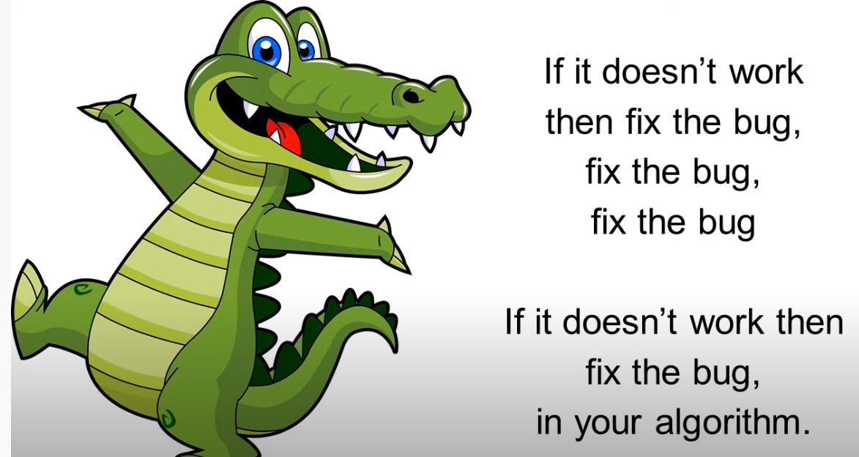
To end on an algorithm song ☺
Algorithm Al (song with lyrics).mkv
Notes:
https://www.youtube.com/watch?v=od_zF0HZWGM

